Slide 1

UNIT 3: Making Machines See
Explore the fascinating world of computer vision: its principles, processes, applications, and future potential.

Slide 2
Learning Objectives
1
2
3
Fundamentals
Process Stages
Applications
Understand computer vision's role in processing visual data.
Explore the various steps in computer vision.
Gain insight into industry uses of computer vision.
4
5
Challenges & Ethics
Future Potential
Identify privacy, security, and misinformation concerns.
Recognize its impact on society.

Slide 3

Why Machines Need to See
The internet is rich with images and videos, but unlike text, indexing and searching visual content is challenging.
Traditionally, visual information relied on manual meta descriptions. We need computers to visually perceive and comprehend images to extract meaningful information.
Challenge: Enabling computers to comprehend images is complex, similar to how children learn by repeated viewing.
Humans easily associate an image (e.g., an apple) with a concept. Machines need similar capabilities to analyze visual data effectively.

Slide 4
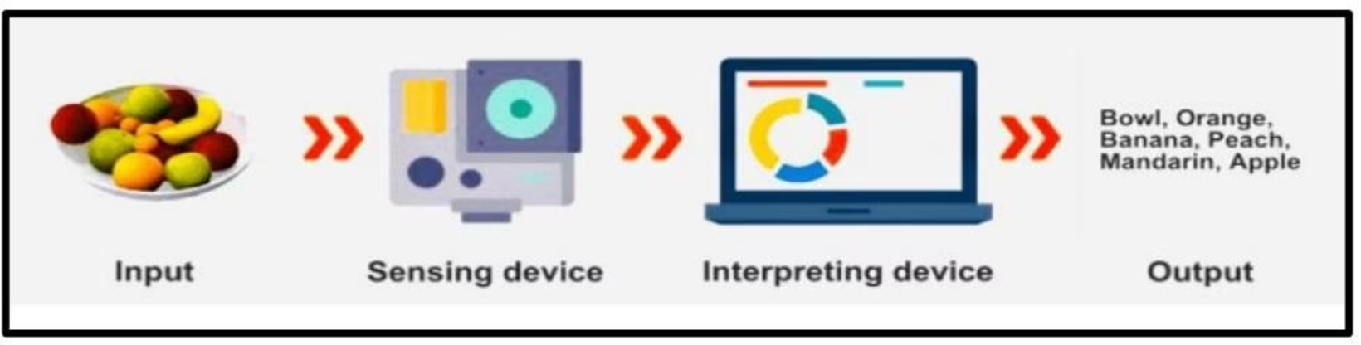
How Machines See: Computer Vision (CV)
Computer Vision (CV) enables systems to see, observe, and understand, much like human vision. It uses cameras, data, and algorithms (similar to retinas, optic nerves, and a visual cortex).
CV systems derive meaningful information from digital images, videos, and other visual input to make recommendations or take actions.
Definition: Computer Vision is an AI field using sensing devices and deep learning models to help systems understand and interpret the visual world.
They inspect products, watch infrastructure, and analyze thousands of processes in real-time, noticing defects or issues with speed, objectivity, and accuracy.

Slide 5

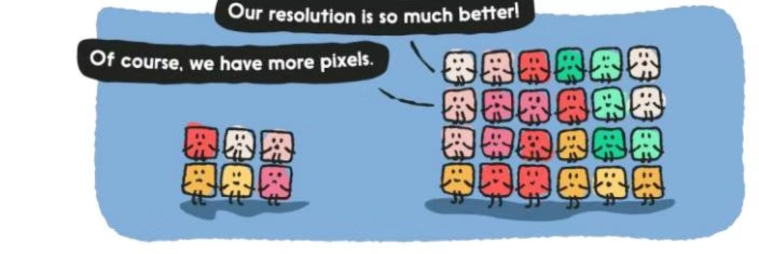
Working of Computer Vision: Digital Images
Basics of Digital Images
A digital image is a picture stored as a sequence of numbers that computers understand. They can be created via design software, digital cameras, or scanners.
Image Interpretation
Computers perceive images as collections of tiny squares called pixels. Each pixel represents a specific color value.
Image resolution is determined by the number of pixels; higher resolution means more detail.
For monochrome images, pixel values range from 0 (black) to 255 (white).

Slide 6





Computer Vision Process: 5 Stages
1. Image Acquisition
Capturing raw digital images or videos.
2. Preprocessing
Enhancing image quality (noise reduction, normalization).
3. Feature Extraction
Identifying relevant visual patterns (edges, corners, textures).
4. Detection/Segmentation
Identifying objects or regions of interest.
5. High-Level Processing
Interpreting and extracting meaningful information.

Slide 7
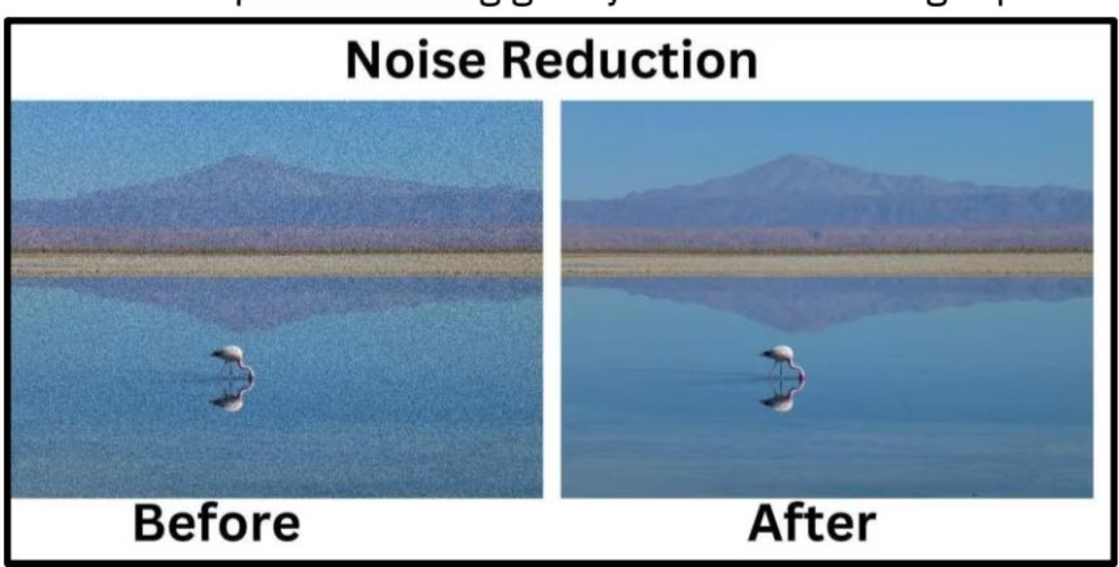
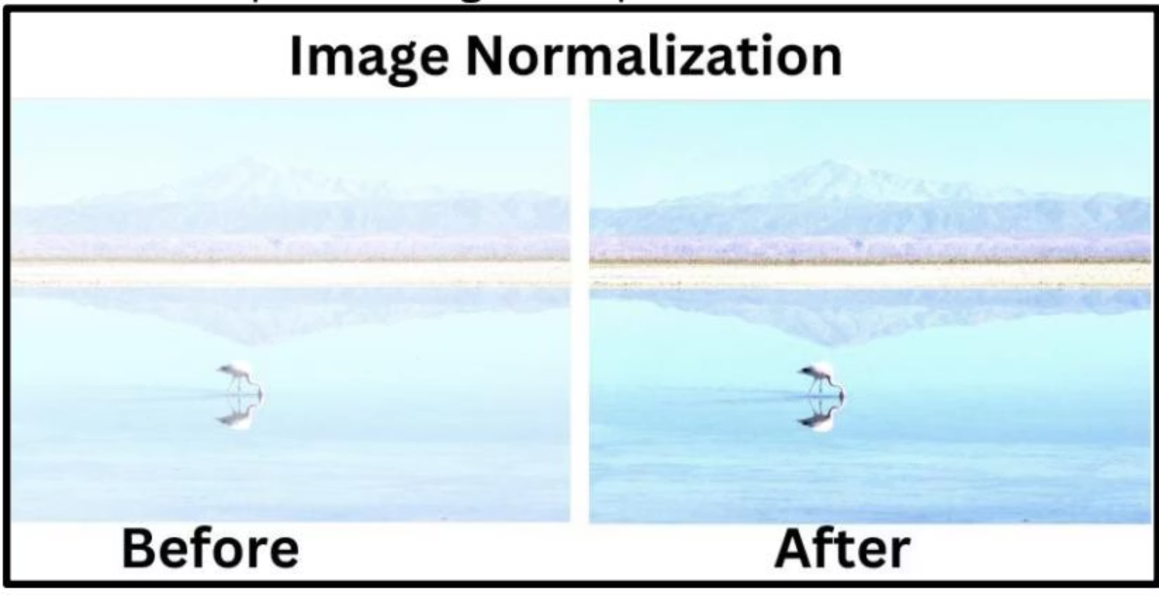
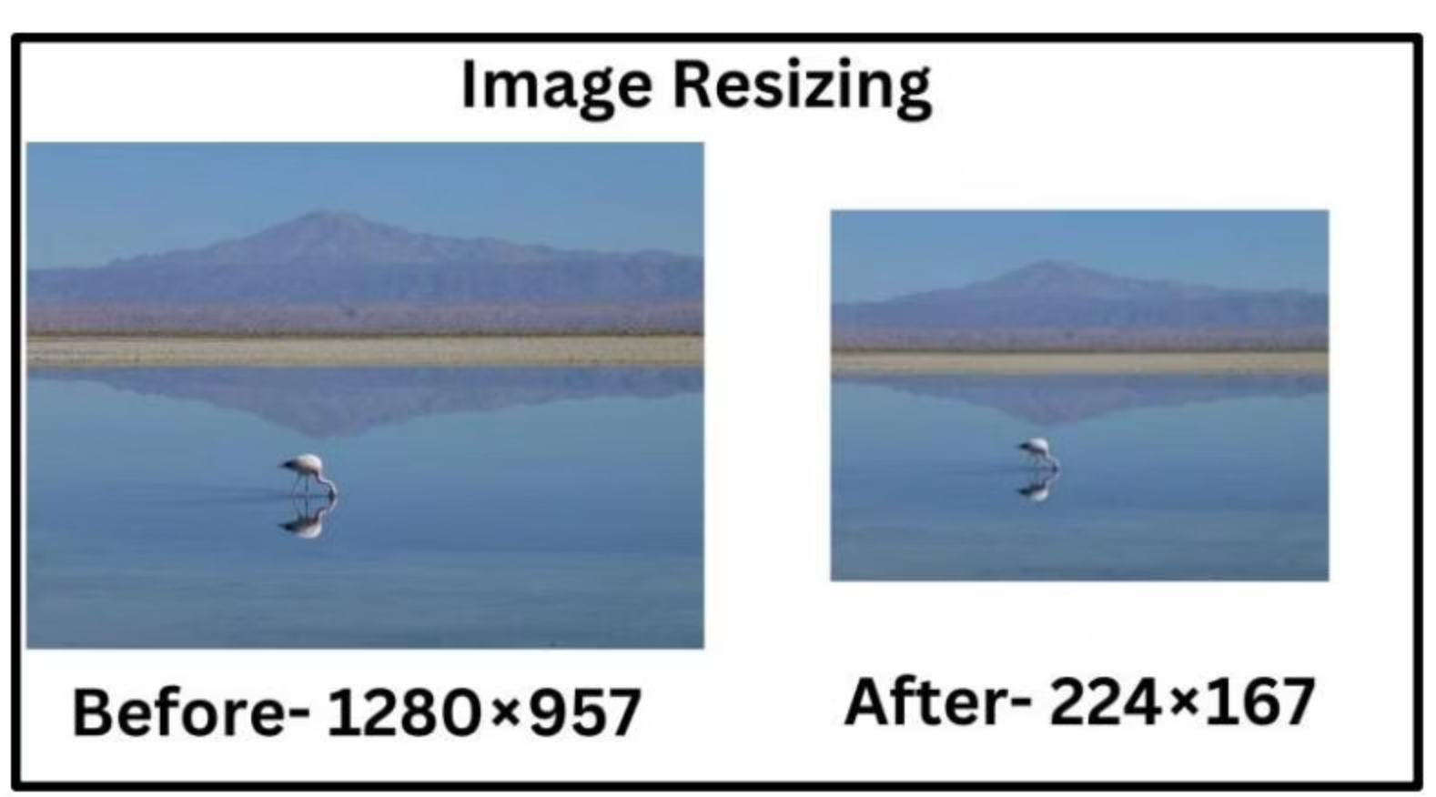
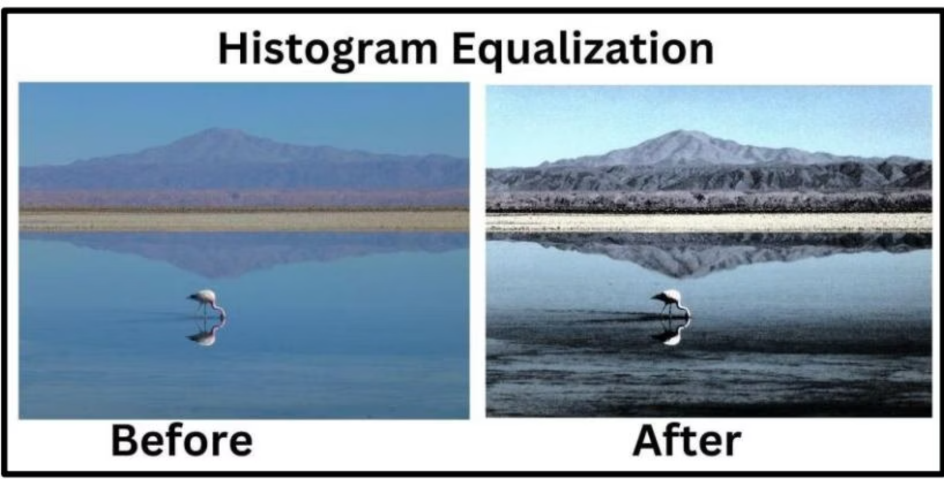
Preprocessing Techniques
Noise Reduction
Image Normalization
Removes unwanted elements like blurriness or distortions.
Standardizes pixel values for consistency across images.
Resizing/Cropping
Histogram Equalization
Changes image dimensions to ensure uniformity for analysis.
Adjusts brightness and contrast to enhance details.

Slide 8
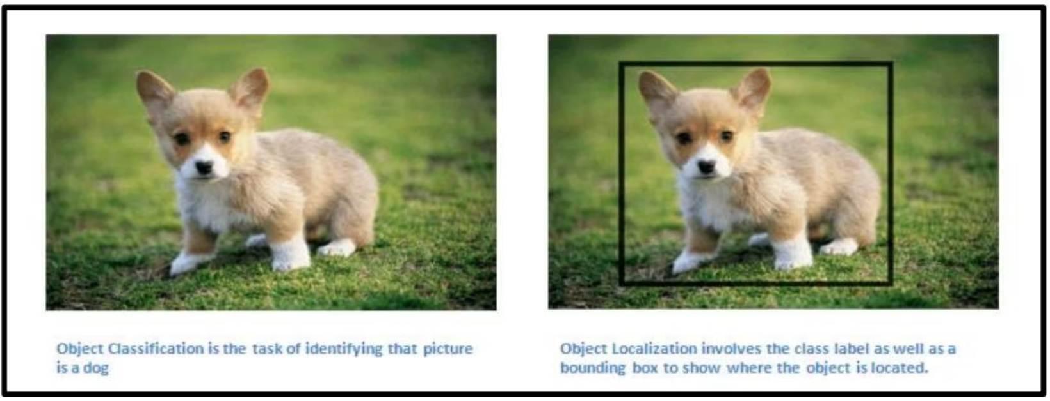
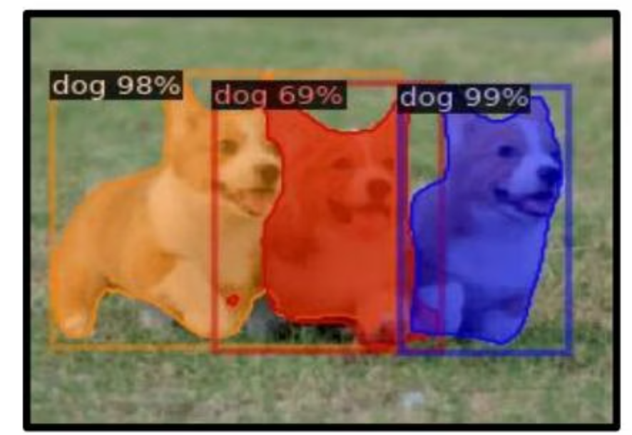
Detection & Segmentation
Single Object Tasks
Multiple Object Tasks
Classification: Determines an object's category.
Object Detection: Identifies and locates multiple objects with bounding boxes and labels.
Classification + Localization: Classifies and precisely locates an object with bounding boxes.
Image Segmentation: Creates masks around pixels with similar characteristics, identifying their class.

Slide 9






Applications of Computer Vision
Facial Recognition
Healthcare
Detects and tags users on social media platforms.
Evaluates tumors, identifies diseases, and tracks objects.
Self-Driving Vehicles
Optical Character Recognition (OCR)
Interprets surroundings, detects objects, and reads signals.
Extracts text from images and documents.
Machine Inspection
Biometrics
Detects defects and irregularities in manufactured products.
Validates user identity via fingerprints and other biometrics.

Slide 10
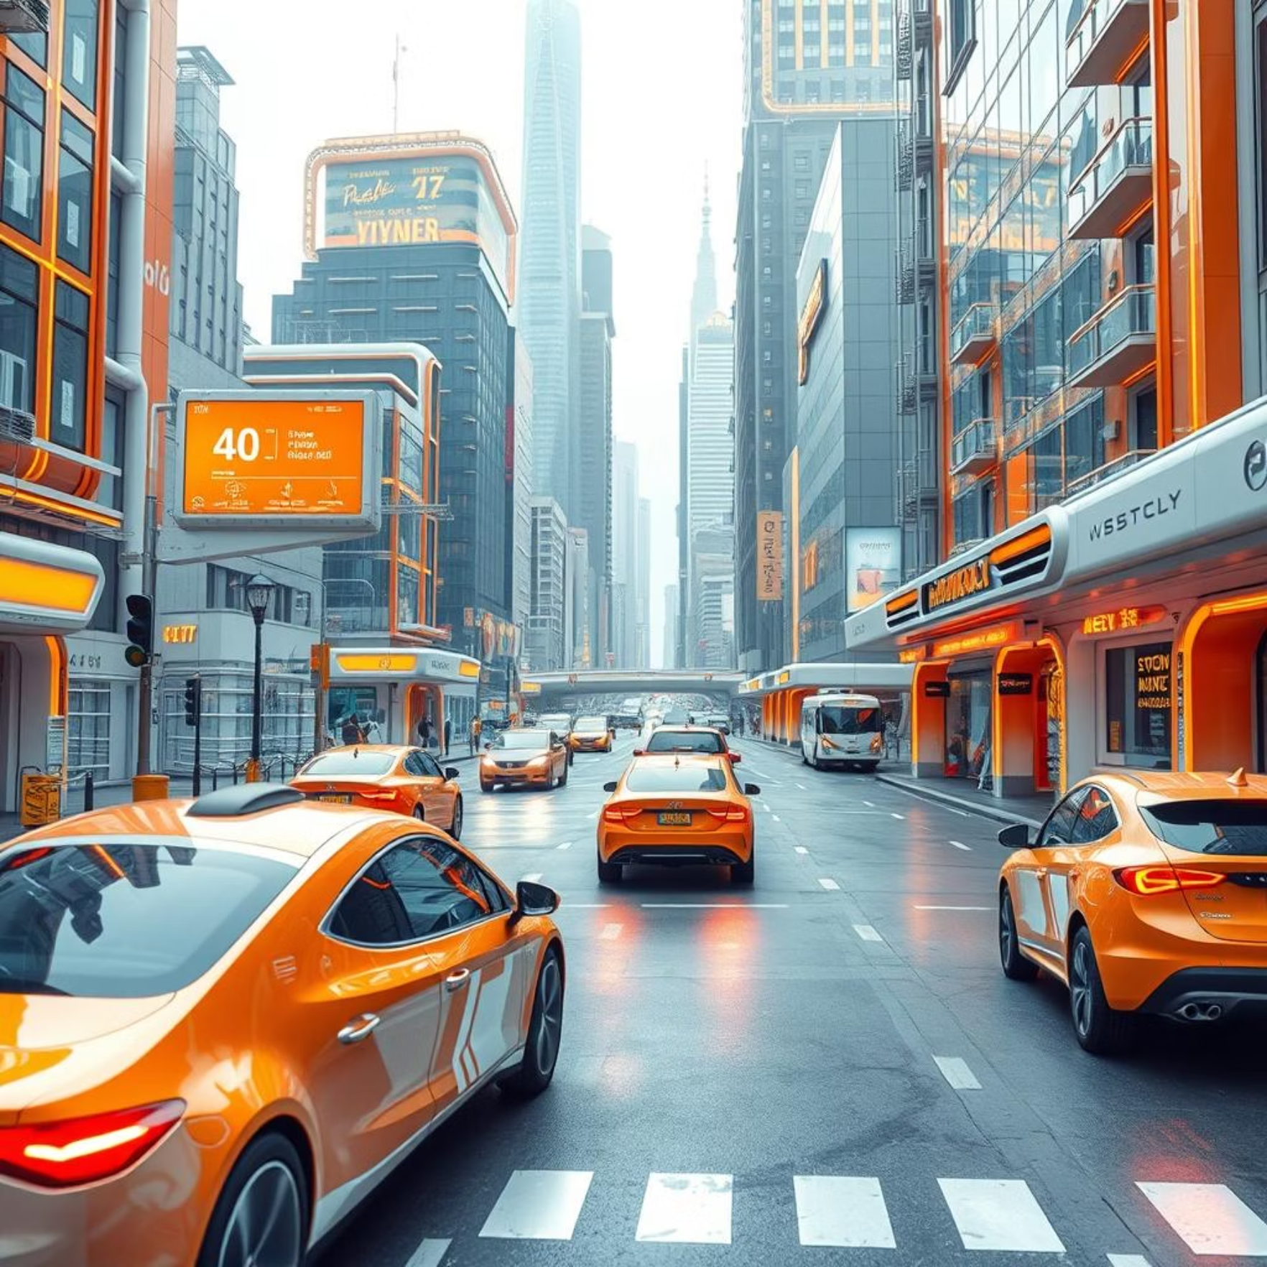
Challenges & Future Potential
Challenges
Future Potential
Reasoning & Analytical Issues: Difficulty in accurate interpretation beyond identification.
Computer vision has evolved from basic image processing to human-like precision, driven by deep learning and vast data.
Image Acquisition: Hurdles due to lighting, perspectives, and occlusions.
Privacy & Security: Concerns with surveillance, facial recognition, and data breaches.
The future promises personalized healthcare diagnostics, immersive AR experiences, and profound societal impact.
Duplicate & False Content: Risk of misleading or fraudulent content.
Embracing innovation and ethical considerations will unlock its transformative power for humanity.

